Slide 1
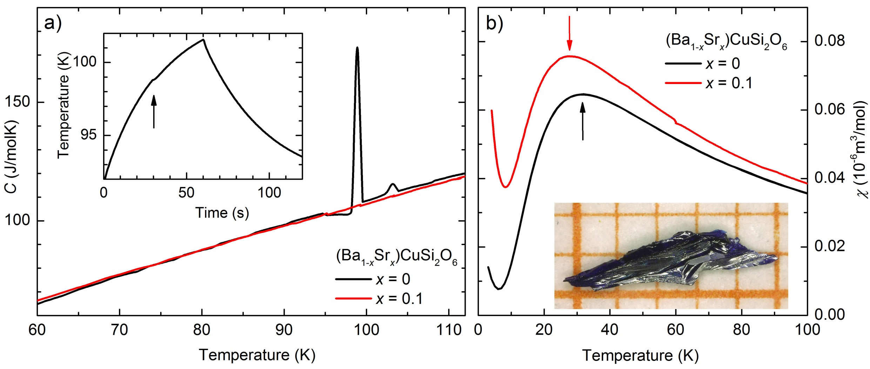
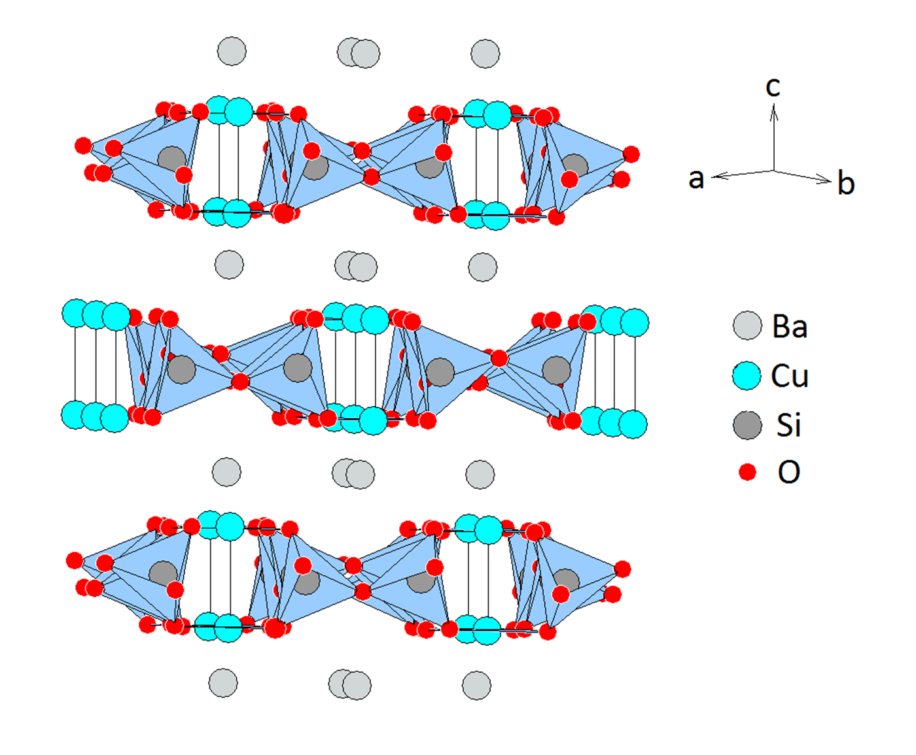
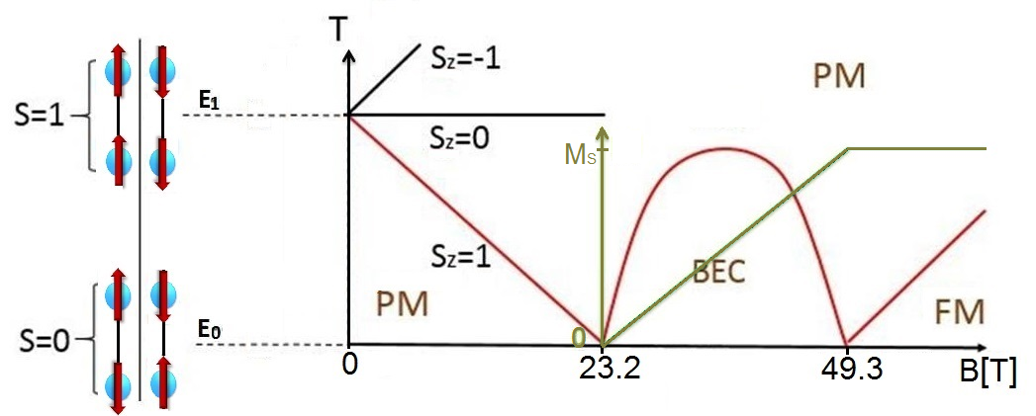
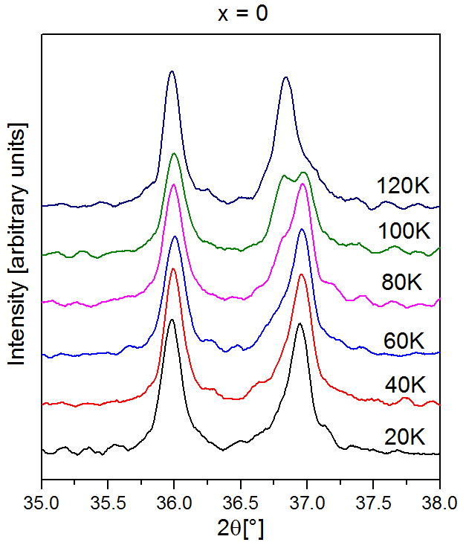
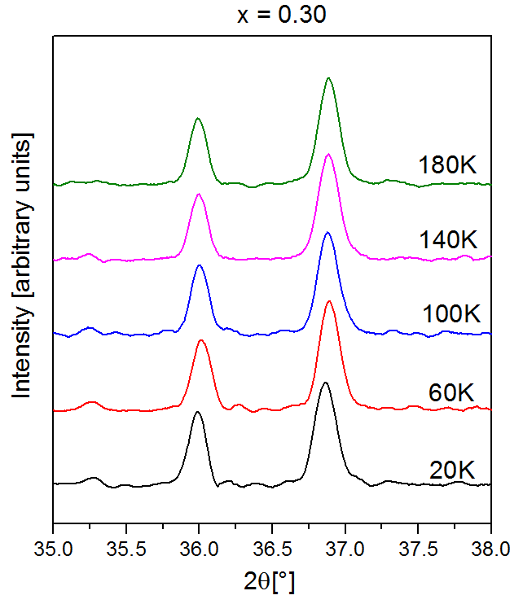

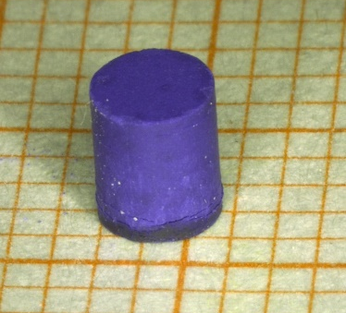
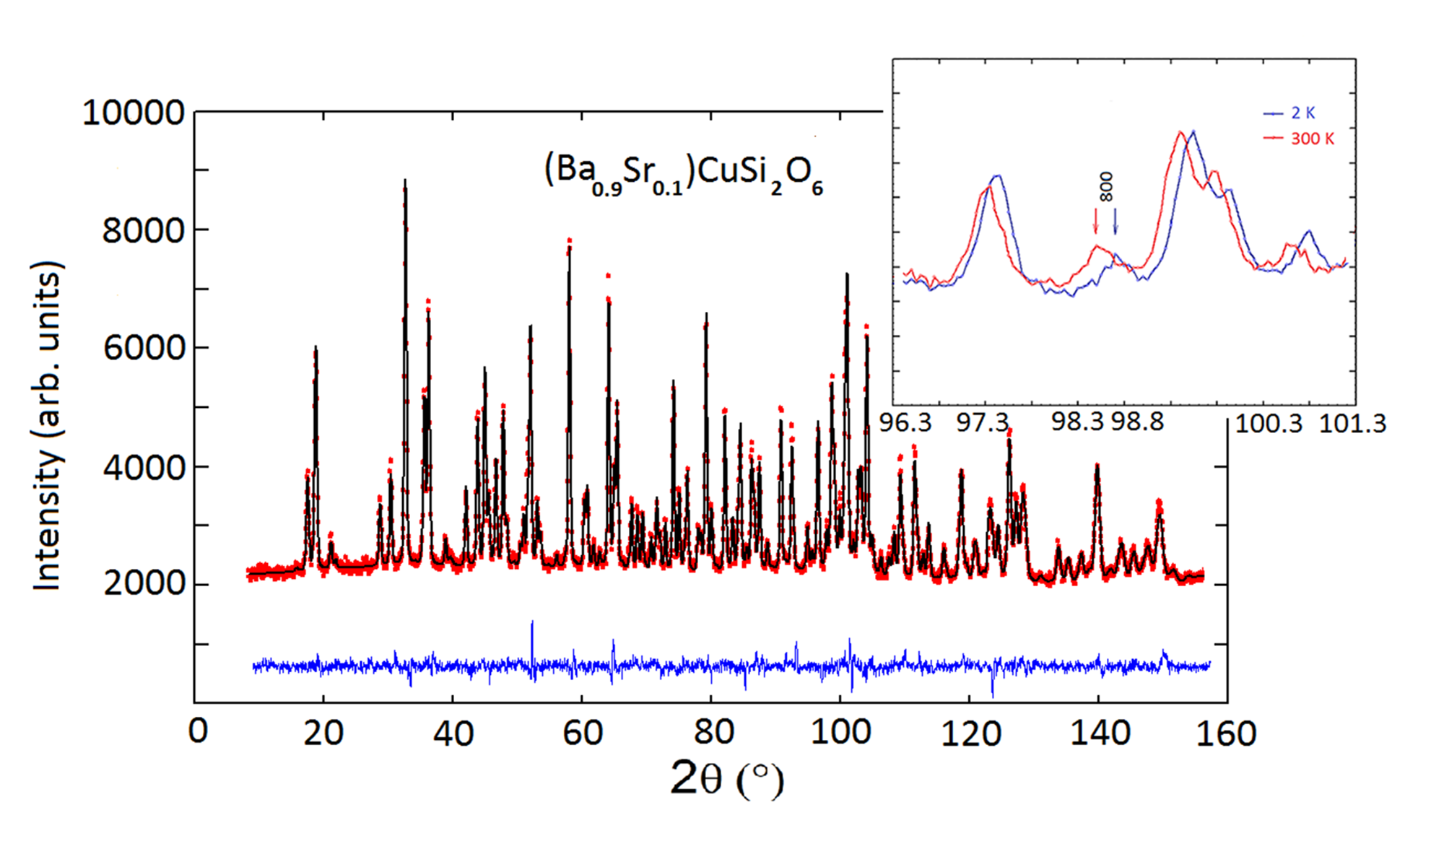
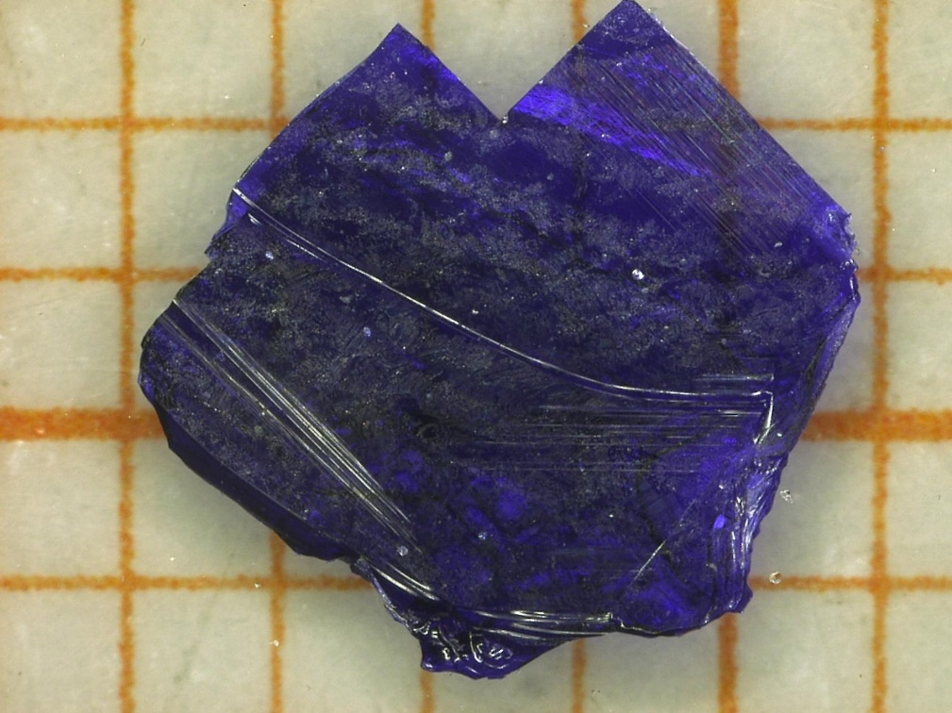
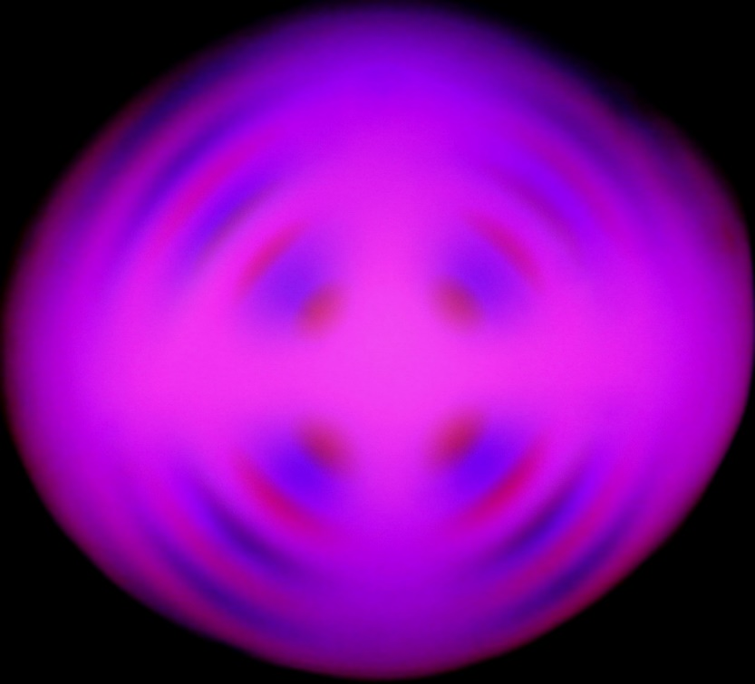
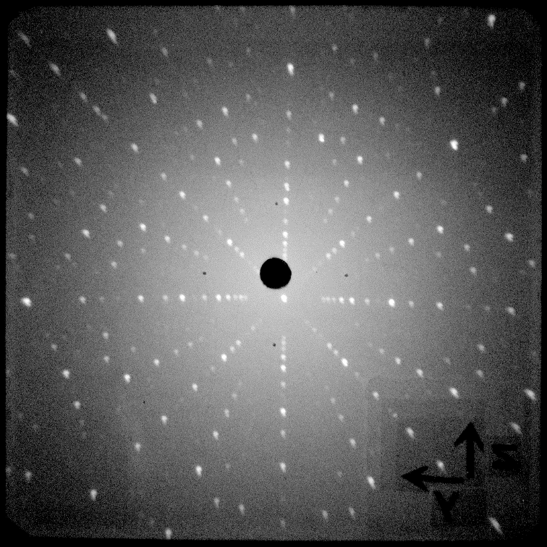
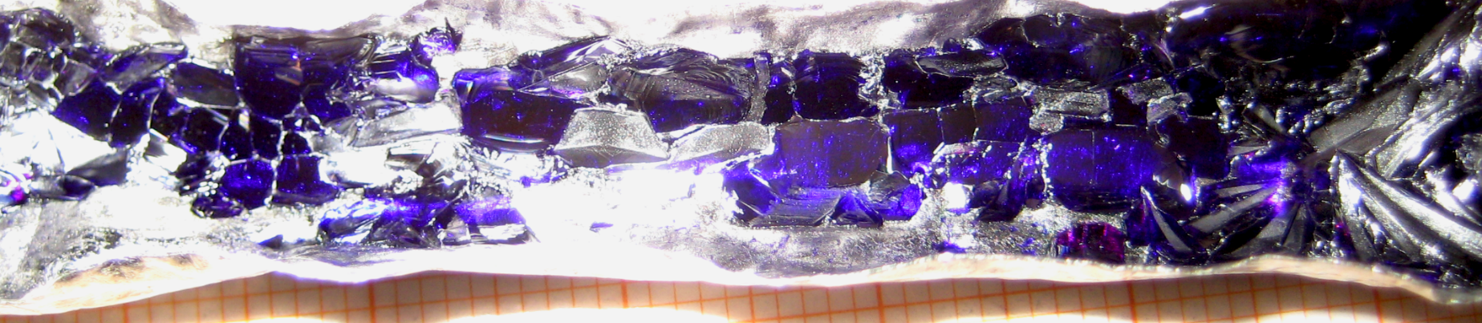
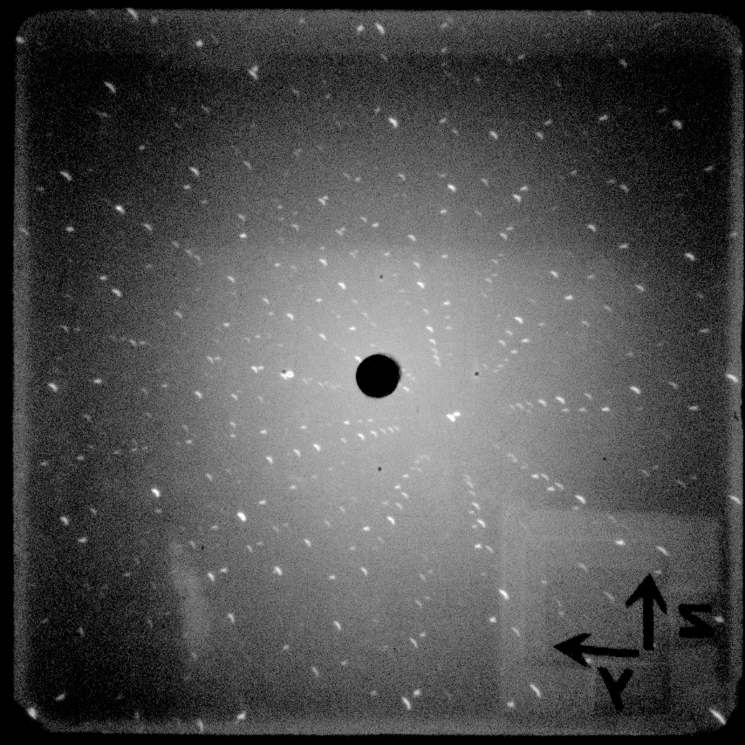
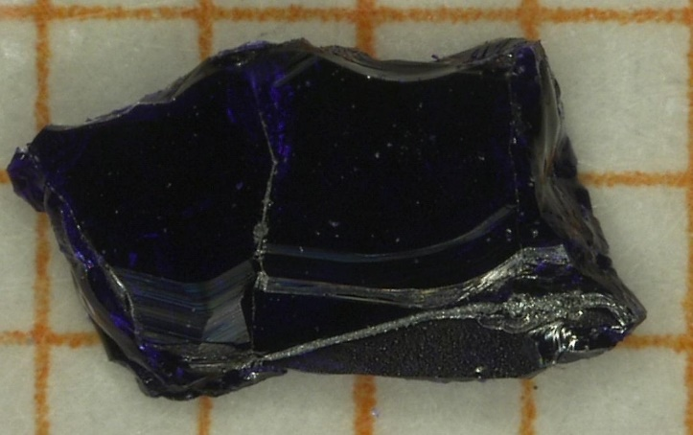
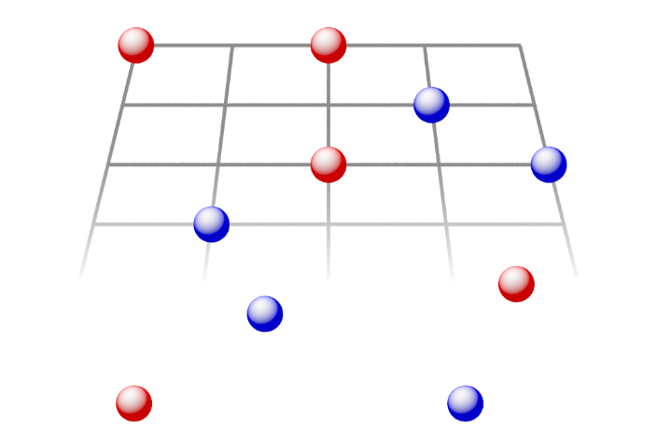
B4
Single crystal growth of tunable quantum spin systems
Franz Ritter, Cornelius Krellner (Goethe-Universität Frankfurt)
Cu-based cyclosilicates: (Ba,Sr)CuSi₂O₆, BaCu(Si,Ge)₂O₆ , BaCu(Si,Sn)₂O₆
Introduction
Suppression of the structural phase transition with Sr-substitution
Tuning the coupled dimer system BaCuSi₂O₆
The Han Purple pigment BaCuSi₂O₆ reveals a Bose-Einstein condensate (BEC) of triplons above H_{c1} = 23.5 T and a dimensional crossover at low temperatures from 3D to 2D at the quantum critical point at H_{c1}.
M. Jaime et al., Phys. Rev. Lett. 93, 087203 (2004)
S. Sebastian et al., Nature 441, 617 (2006)
The tetragonal crystal structure at room temperature, symmetry group I4₁/acd s changed below 100 K to the orthorhombic Ibam, leading to two different type of adjacent Cu-dimers in the low-temperature phase.
D. Sheptyakov et al., Phys. Rev. B 86, 014433 (2012)
a) For x = 0, a first-order phase transition is visible at ~100 K which is suppressed for x = 0.1. b) Susceptibility for two crystals with x = 0 and x = 0.1. The broad maximum shifts to lower T with increasing x, indicating a decrease of the intra-dimer coupling.
This is in agreement with preliminary low-T high-field magnetization data.
B1
x = 0
x = 0.3
Studies on BEC:
A3
A5
A7
A8
A9
A10
A12
B1
B2
B5
B13_{N}
Achievements
Temperature dependent powder x-ray diffraction for x = 0 and x = 0.3 around the structural phase transition. Refined crystal structure at low T is starting point for extended LDA calculations. For x = 0.1, the two leading couplings from the calculations are J_{intra} and J_{inter} with J_{inter} /J_{intra} = 0.14.
B2
Synthesis
H. Berke, Angew. Chem. 114, 2595 (2002):
Various Sr, Ge substitutions sintered at x-dependant temperatures:
$${BaCO}_{3}+CuO+{2SiO}_{2}\underset{→}{1035°C}BaCu{Si}_{2}O_{6}+CO_{2}$$
$${(1−x)BaCO}_{3}+{xSrCO}_{3}+CuO+{2SiO}_{2}→{Ba}_{1−x}{Sr}_{x}Cu{Si}_{2}O_{6}+CO_{2}$$
$${BaCO}_{3}+CuO+{(2−x)SiO}_{2}+xGeO_{2}→BaCu{Si}_{2−x}{Ge}_{x}O_{6}+CO_{2}$$
Crystal growth techniques
Neutron diffraction data for x = 0.1 prove the tetragonal crystal structure with one sort of dimers for x = 0.1. These data were measured at the PSI in collaboration with Christian Rüegg and Denis Sheptyakov. In addition, we will investigate this material in an approved proposal for low-T synchrotron time.
I. Flux growth method
S. E. Sebastian et al., Phys. Rev. B 74, 180401(R) (2006):
BaCuSi₂O₆ single crystal growth using LiBO₂ as external flux.
Successful improvement using new flux KBO₂ and NaBO₂/NaF giving rise to crystals of up to 5 x 5 x 1 mm³ with ~35 mg.
Project goals and work program
Optimization of the growth of large and high-quality single crystals using O₂ partial pressure for various substitutions of Sr, Ge, and Sn.
Implementation and optimization of hydrothermal growth for Cu-based cyclosilicates at ~250°C. Y. Chen et al., Dyes and Pigments 105, 167 (2014).
Structural characterisation using pair distribution functional (PDF) analysis of synchrotron data.
Pressure induced stabilization of the tetragonal structure in BaCuSi₂O₆ at low temperatures (pending synchrotron proposal)
Investigation of the dimensional crossover from 3D to 2D for x_{Sr} = 0.1 at H_{c1}
High field measurements to characterize BEC of substituted systems
a)
b)
c)
a) Single crystal of BaCuSi₂O₆ b) Conoscopic image and c) Laue-diffraction reveal the typical layered growth along the crystallographic c-direction
II. Growth from the melt under O₂ partial pressure
B1
B2
B13_{N}
M. Jaime et al., Phys. Rev. Lett. 93, 087203 (2004):
BaCuSi₂O₆ single crystal growth by the floating zone technique in an O₂ atmosphere.
Optimization of the crystal growth for Sr substituted samples, achieved crystal size about 3 x 4 x 1 mm³ with ~18 mg.
  Requested funding
Research staff: Pascal Puphal (Ph.D. student).
Pascal Puphal will perform crystal growth experiments as well as the structural and physical characterization with the main focus on the Cu-based cyclosilicates and the (Zn_{1−x}Ga_{x})Cu₃(OH)₆Cl₂ systems. Furthermore, he will prepare single crystals of the Cs₂CuCl_{4-x}Br_{x} series for advanced measurements and perform susceptibility and specific-heat measurements of the other kagome materials.
Small equipment:
    Large bore VSM option for the PPMS, for magnetic characterization of large single crystals (> 4 mm)
    Hydrothermal autoclave for the F-based Kagome systems
    Box furnace for the synthesis of the F-based Kagome systems
a)
Sr_{0.1}Ba_{0.9}CuSi₂O₆ crystal growth:
As grown crystals in Pt-boat
Selected single crystal
Laue-diffraction pattern of a single crystal along c
b)
c)
Transregional Collaborative Research Centre SFB/TR 49
Frankfurt / Kaiserslautern / Mainz

